Slide 1
Introduction to Arduino Microcontroller
Prepared by:
Md. Asaduzzaman
Dept of ICT, MBSTU

Slide 2
Contents
What is Microcontroller?
What is Arduino?
Types of Arduino?
Installation process
Types Sensors? - Digital, Analog sensors.
Motor control
Coding structure and examples with C/C++ Library File? 1. Data types and operators. 2. What is “Function”? 3. Control statements [if, if… else, switch case.]. 4. Loop statements[while, for, do… while.]. 5. Common functions.

Slide 3
What is a Microcontroller ?

Slide 4
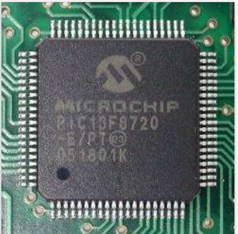
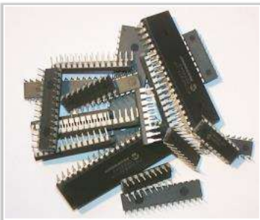
Microcontroller
It is a micro-computer. As any computer it has internal CPU, RAM,IOs interface.
Microcontroller = internally (CPU+RAM+IO interface) integrated device
It is used for control purposes, and for data analysis.
Must Need a Programmer.
Work as, both Master or Slave device.
Famous microcontroller manufacturers are MicroChip, Atmel,Atmega, Intel,IBM etc.

Slide 5
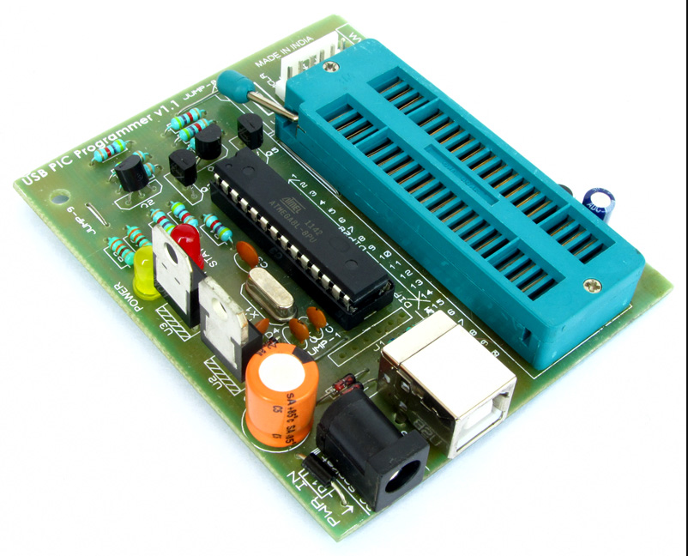
Microcontroller Programmer
Hardware :
PIC Programmer, Pocket AVR Programmer etc.
Software : (AVR,AVRISP,USBISP,USBASP) .
USB PIC Microcontroller Programmer

Slide 6
What is the difference between Microcomputer and Microcontroller ?

Slide 7
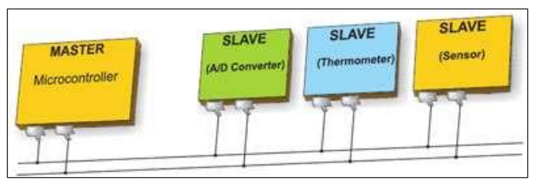
What is Arduino Microcontroller ??
It is Open Source (Hardware + Software) and single board microcontroller.
Work as, both Master or Slave device.
Arduino = internally CPU+RAM+IO interfaces + programmer (AVR,AVRISP,USBISP,USBASP) .
In 2005, a project was initiated to make a device for controlling student-built interactive design projects that was less expensive than other prototyping systems available at the time.
Founders Massimo Banzi and David Cuartielles named the project after Arduin of Ivrea and began producing boards in a small factory located in Ivrea.

Slide 8
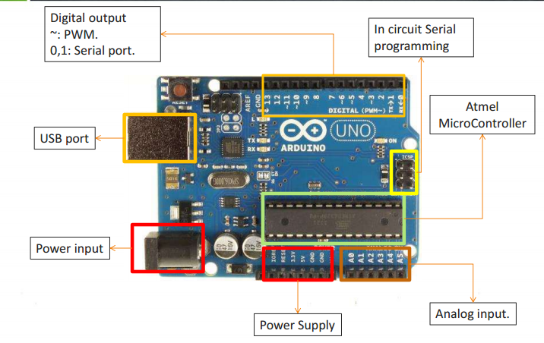
General Structure of Arduino ?

Slide 9
Arduino Specification
Microcontroller ATmega328
Operating Voltage 5V and 3.3 V
Baud Rate : 9600, 14400, 19200, 28800, 38400, 57600, or 115200 bps.
Input Voltage (recommended) 7-12V
Input Voltage (limits) 6-20V
Digital I/O Pins 14 (of which 6 provide PWM output)
Analog Input Pins 6
DC Current per I/O Pin 40 mA
DC Current for 3.3V Pin50 mA
Flash Memory 32 KB (ATmega328) of which 0.5 KB used by Bootloader
SRAM 2 KB (ATmega328)
EEPROM 1 KB (ATmega328)
Clock Speed 16 MHz
Other Prototyping Platform:
Raspberry pie
Beagle board
Panda board
Cotton candy
Cubie Board
APC Rock
Hackberry
Gooseberry

Slide 10
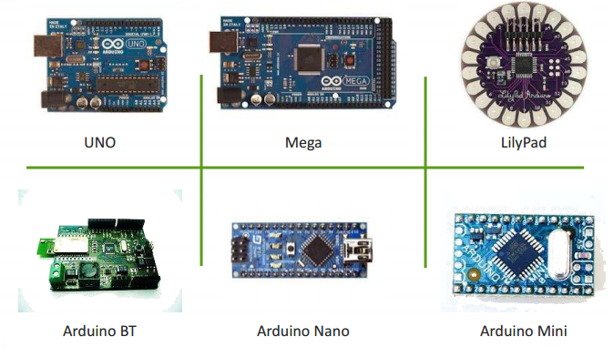
Types of Arduino ?

Slide 11
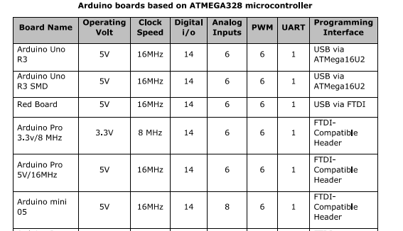
Specification of different Types of Arduino -01

Slide 12
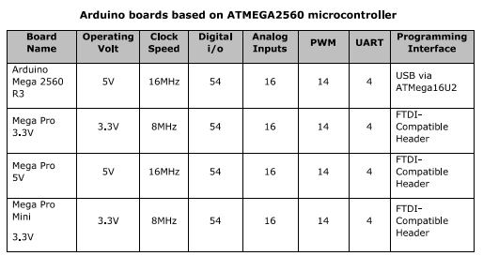
Specification of different Types of Arduino -02

Slide 13
Arduino Based Sensor

Slide 14
Types of Sensor
Two types:
Digital Sensor
Analog Sensor

Slide 15
Frequently Used Sensor
Humidity sensor (DHT22) - Digital Sensor
Temperature sensor (LM35) - Analog Sensor
Water detector sensor (Simple Water Trigger) - Digital Sensor
PIR SENSOR - Digital Sensor
ULTRASONIC SENSOR - Digital Sensor
Sound Sensor - Digital Sensor
GPS

Slide 16
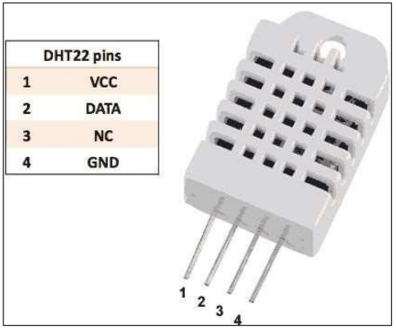
Humidity Sensor (DHT22) –Digital Sensor
Technical Details
Power − 3-5V
Max Current − 2.5mA
Humidity − 0-100%, 2-5% accuracy
Temperature − 40 to 80°C, ±0.5°C accuracy

Slide 17
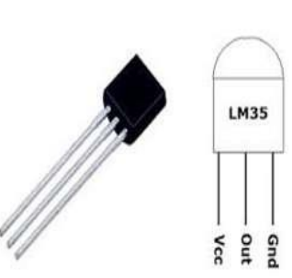
Temperature Sensor (LM35) Analog Sensor
Technical Specifications:
Calibrated directly in Celsius (Centigrade)
Linear + 10-mV/°C scale factor.0.5°C ensured accuracy (at 25°C)
Rated for full −55°C to 150°C range
Suitable for remote applications

Slide 18
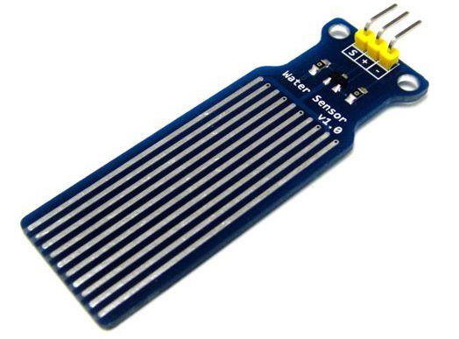
Water Sensor (Digital Sensor)
Technical Specification:
Water sensor has three terminals –
S,V_{out}(+), and GND (-).
Connect the sensor as follows −
Connect the +V_{s} to +5v on your Arduino board.
Connect S to digital pin number 8 on Arduino board.
Connect GND with GND on Arduino.

Slide 19
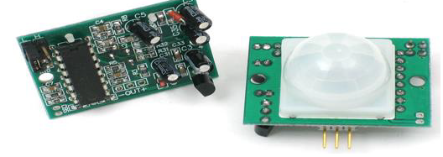
PIR (Pyroelectric/Passive Infrared Radiation) Sensor (Digital Sensor)
Technical Specification:
PIR sensor has three terminals : V_{cc}, OUT and GND.
Connect the sensor as follows −
Connect the +V_{cc} to +5v on Arduino board.
Connect OUT to digital pin on Arduino board.
Connect GND with GND on Arduino.

Slide 20
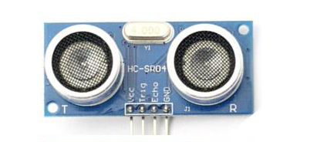
Ultrasonic Sensor (HC-SR04) - Digital Sensor
Technical Specifications
Power Supply − +5V DC
Quiescent Current − <2mA
Working Current − 15mA
Effectual Angle − <15°
Ranging Distance − 2cm – 400 cm/1″ – 13ft
Resolution − 0.3 cm
Measuring Angle − 30 degree
Connect the +5V pin to +5v on your Arduino board.
Connect Trigger to digital pin 7 on your Arduino board.
Connect Echo to digital pin 6 on your Arduino board.
Connect GND with GND on Arduino.

Slide 21
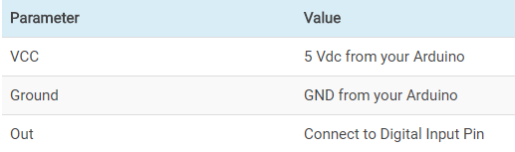
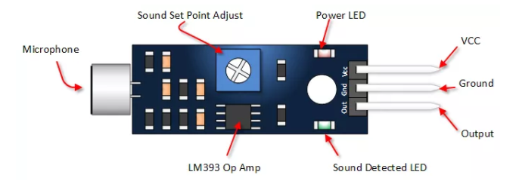
Sound Detection Sensor (Digital Sensor)

Slide 22
Control the different type of motor with Arduino

Slide 23
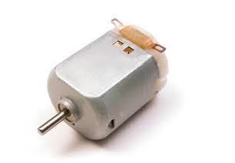
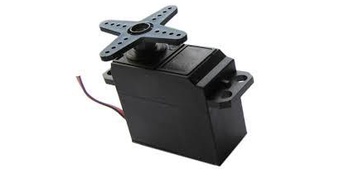
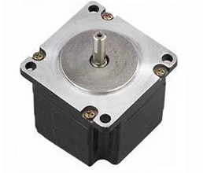
Types of Motor ??
There are three different type of motors −
DC motor
Servo motor
Stepper motor
DC Motor
Stepper motor
Servo motor

Slide 24
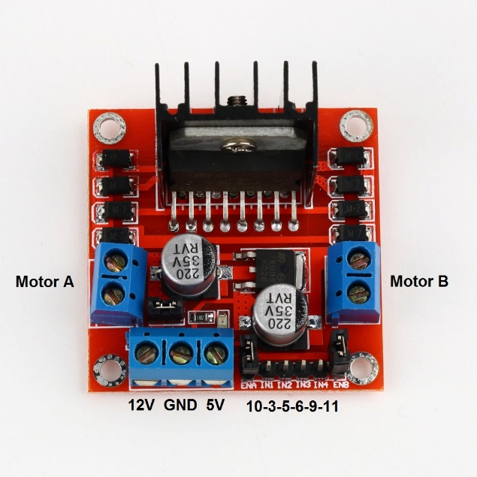
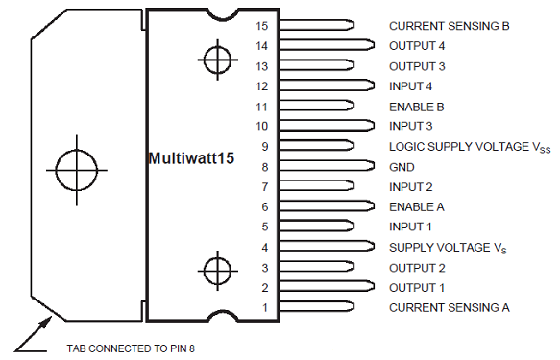
Necessary Things to done a Project with Motor
Motor Driver : To control the direction of the spin of DC motor, without interchanging the leads, you can use a circuit called an H-Bridge(Motor Driver). An H-bridge is an electronic circuit that can drive the motor in both directions.
Example : L298, L293 ,ESC etc.
L298 Motor Driver

Slide 25
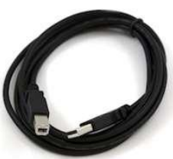
Arduino Installation
First you must have your Arduino board and a USB cable.
Download Arduino IDE and driver.
IDE Link: ARDUINO 1.8.5 : https://www.arduino.cc/en/Main/Software
(go for windows installer) Download and Install it.
Driver Link: https://www.dropbox.com/s/a1d4837hbfylipb/windows-driver-installer.exe?dl=0 Download and Install it.

Slide 26
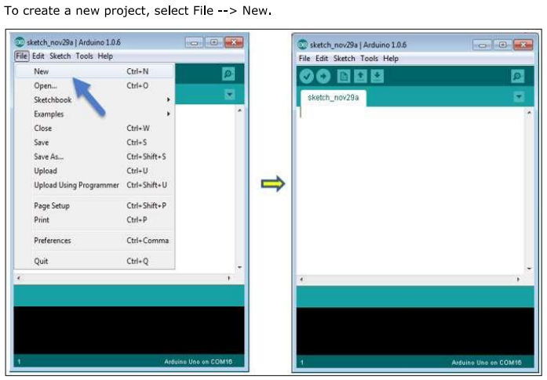
Run on IDE

Slide 27
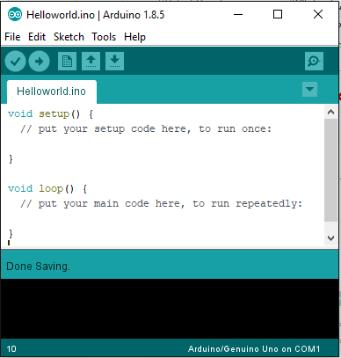
Basic Structure of a Sketch
Open/Create a Sketch and Save it with .ino extension.

Slide 28
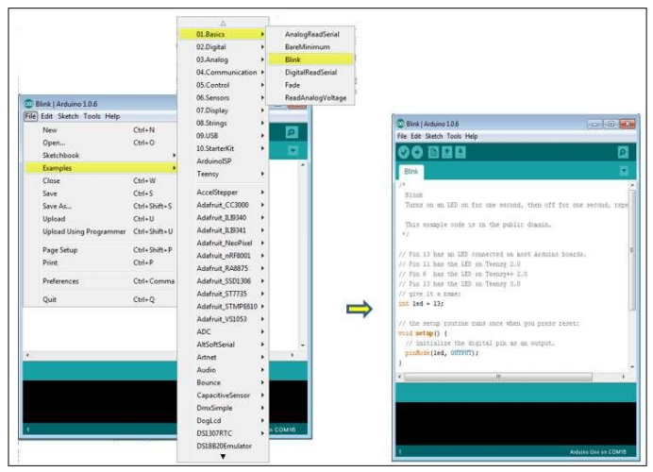
Open an Example Sketch

Slide 29
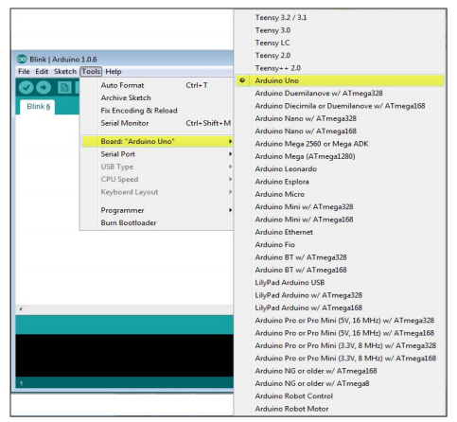
Select a Board

Slide 30
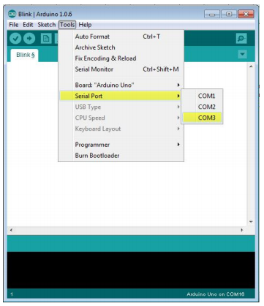
Select a Communication port

Slide 31
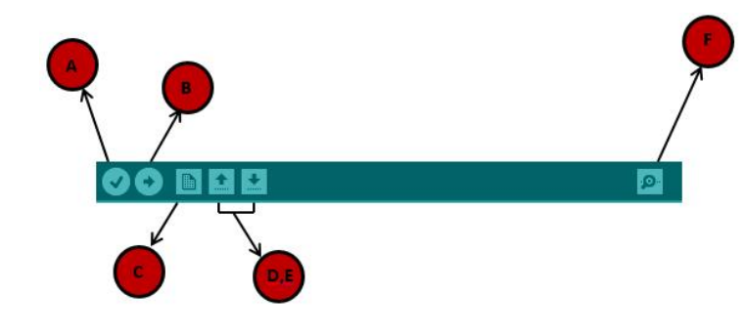
Upload a Sketch
A - used to check compile error.
B - Upload the program (Sketch).
C - Create new Sketch.
D - Open a Sketch.
E - Save a Sketch.
F – Serial monitor is Used to Visualize of transformation of serial data.

Slide 32
Arduino Programming with C/C++ Library File

Slide 33
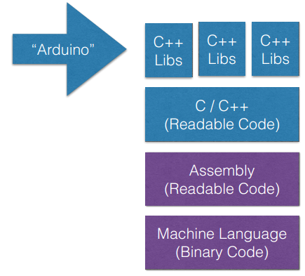
Life Cycle of Arduino Sketch

Slide 34
Input and Output Function
pinMode(Pin_no, Mode);
Mode= Input/Output on Analog or Digital pin
digitalRead(D_Pin_no);
digitalWrite(D_Pin_no, High/Low);
delay(time_ms);
other functions:
analogRead(A_Pin_no);
analogWrite(A_pin_no, PWM_input); //PWM.

Slide 35
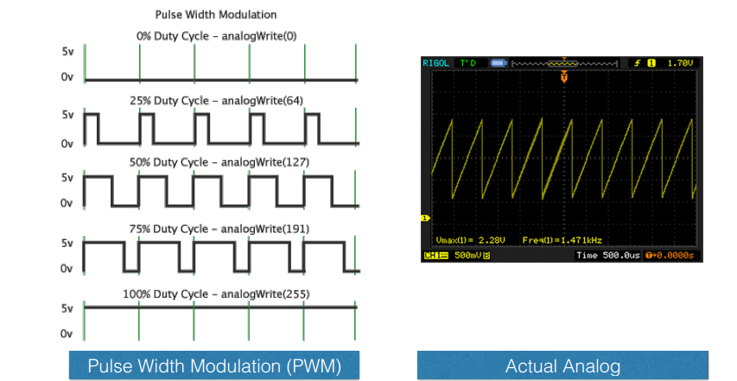
PWM (Pulse Width Modulation)

Slide 36
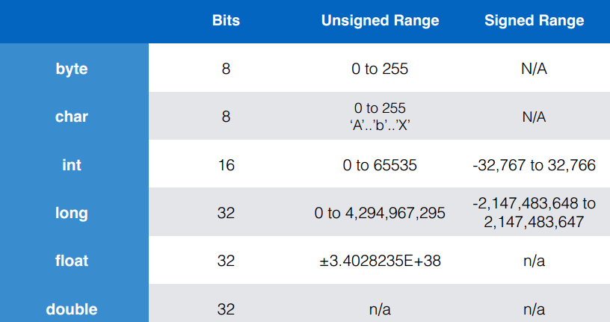
Data Type : Like as C/C++

Slide 37
Operators : Like as C/C++
- Math operators: [+,-,*,/,%,^,++]
- Logic operators: [==, !=, &&, || ]
- Comparison operators: [==, >, <, !=, <=, >=]
Compound Operators: ++ (increment) -- (decrement) += (compound addition) -= (compound subtraction) *= (compound multiplication) /= (compound division)
- Other : ; = Semicolon, {} = curly braces, // = single line comment,
/*Multi-line comments*/

Slide 38
Control Statement: Like as C/C++
If(condition) {…………}
If(condition) {………….} else {…………..}
If (condition) {…} else if (condition) {….} else {………}
switch (var) { case 1: //do something when var equals 1 break; case 2: //do something when var equals 2 break; default: // if nothing else matches, do the default // default is optional }

Slide 39
Loop Statement: Like as C/C++
Do… while: do { Statements;
break;
}
while(condition); // the statements are run at least once.
While: While(condition) {statements; break; }
for for (int i=0; i <= val; i++){ statements;
break; }

Slide 40
Basic Structure of a Simple Project: 01 Blinking LED (Send a Digital Serial Write command to a Slave (Sensors, LEDs, Motors etc.))
void setup() //the setup function runs once when you press reset or power the board.
{
pinMode(3, OUTPUT); // initialize digital pin 3 as an output.
}
void loop() // the loop function runs over and over again forever.
{
digitalWrite(3, HIGH); // turn the LED on (HIGH is the voltage level).
delay(1000); // wait for a second.
digitalWrite(3, LOW); // turn the LED off by making the voltage LOW.
delay(1000); // wait for a second.
}

Slide 41
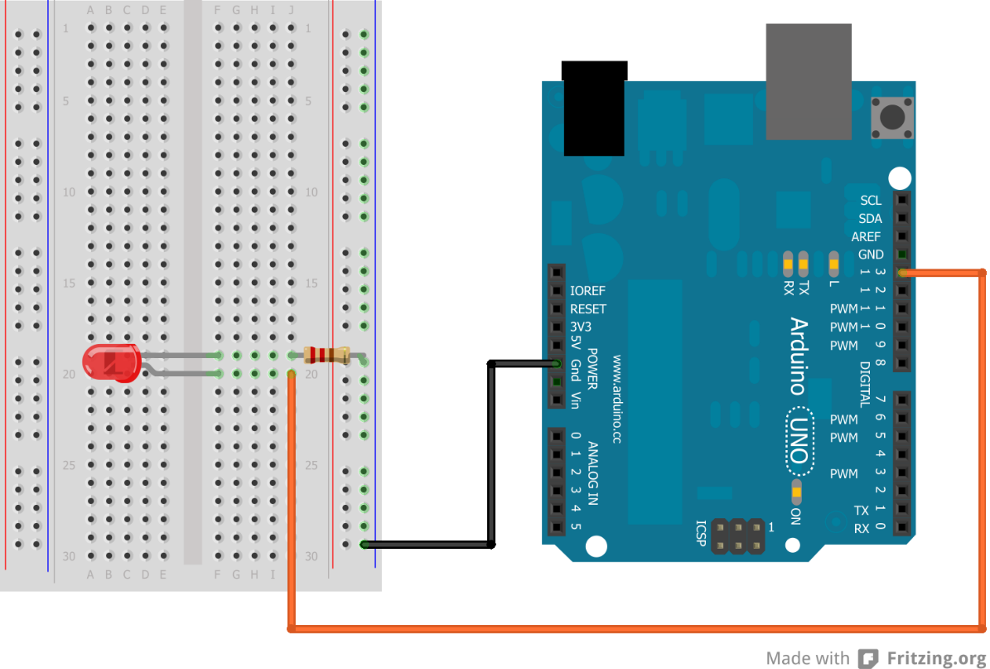
Circuit Diagram of Project: 01

Slide 42
Basic Structure of a Simple Project: 02 Digital Serial Data Reading (Receive a command from a Slave (Sensors, LEDs, Motors etc.))
int pushButton = 2; // digital pin 2 has a pushbutton attached to it. Give it a name:
void setup()
{
Serial.begin(9600); // initialize serial communication at 9600 bits per second:
pinMode(pushButton, INPUT); // make the pushbutton's pin an input:
}
void loop()
{
int buttonState = digitalRead(pushButton); // read the input pin:
Serial.println(buttonState); // print out the state of the button:
delay(1); // delay in between reads for stability
}

Slide 43
Basic Structure of a Simple Project: 03 Analog Serial Data Reading (Receive a command from a Slave ((Sensors, LEDs, Motors etc.))
void setup()
{
Serial.begin(9600); // initialize serial communication at 9600 bits per second:
}
void loop()
{
int sensorValue = analogRead(A0); // read the input on analog pin 0:
float voltage = sensorValue*(5.0/1023.0);
// Convert the analog reading(0-1023) to a voltage(0-5V):
Serial.println(voltage); // print out the value you read:
}

Slide 44
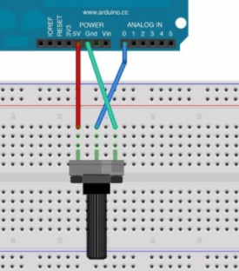
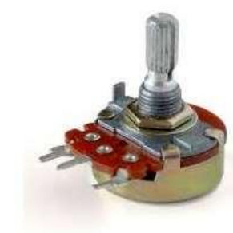
Circuit diagram of Project- 03
Potentiometer

Slide 45
Basic Structure of a Simple Project: 04 (Send a Analog Serial Write PWM command to a Slave (Sensors, LEDs, Motors etc.))
void setup()
{
Serial.begin(9600); // initialize serial communication at 9600 bits per second:
}
void loop()
{
int Value = random(0,1023);
//set a analog serial data (which goes from 0 - 1023) to a voltage (0 - 5V):
float voltage = Value * (5.0 / 1023.0);
analogWrite(A1,voltage); // write the input on analog pin 1:
Serial.println(voltage); // print out the value you write:
}

Slide 46
Can anyone tell us the Sketch (code) of merging the idea of Project -01,02,03 and Project -04 ??

Slide 47
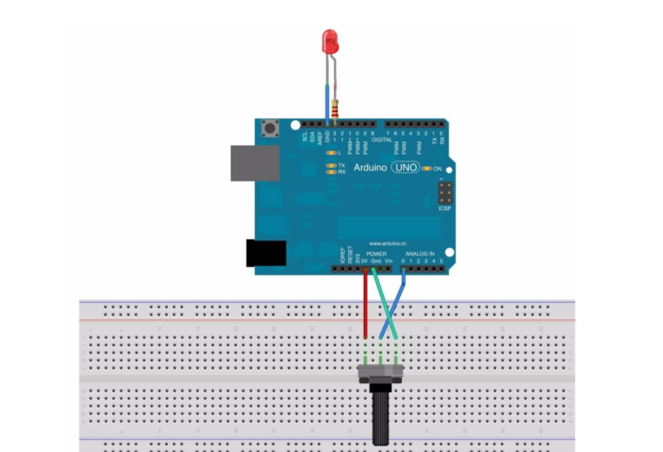
Merge circuit Diagram of Project -03 and Project -04

Slide 48
Test Our Skills : (PWM) Anyone Please explain Where PWM is used?
int led = 3,brightness = 0,fadeAmount = 5;
void setup()
{
pinMode(led, OUTPUT);
}
void loop()
{
analogWrite(led, brightness);
brightness = brightness + fadeAmount;
if (brightness == 0 || brightness == 255)
{
fadeAmount = -fadeAmount ;
}
delay(30);
}

Slide 49
Basic Project -05 Control the Spin of Motor
void loop()
{
digitalWrite(in_1,HIGH) ;
digitalWrite(in_2,LOW) ;
analogWrite(pwm,255) ; //Clockwise for 3 secs
delay(3000) ;
digitalWrite(in_1,LOW) ;
digitalWrite(in_2,HIGH) ;
delay(3000) ; //Anti-Clockwise for 3 secs
}
const int pwm = 10 ;
const int in_1 = 9 ;
const int in_2 = 8 ;
void setup()
{
pinMode(pwm,OUTPUT) ;
pinMode(in_1,OUTPUT) ;
pinMode(in_2,OUTPUT) ;
}

Slide 50
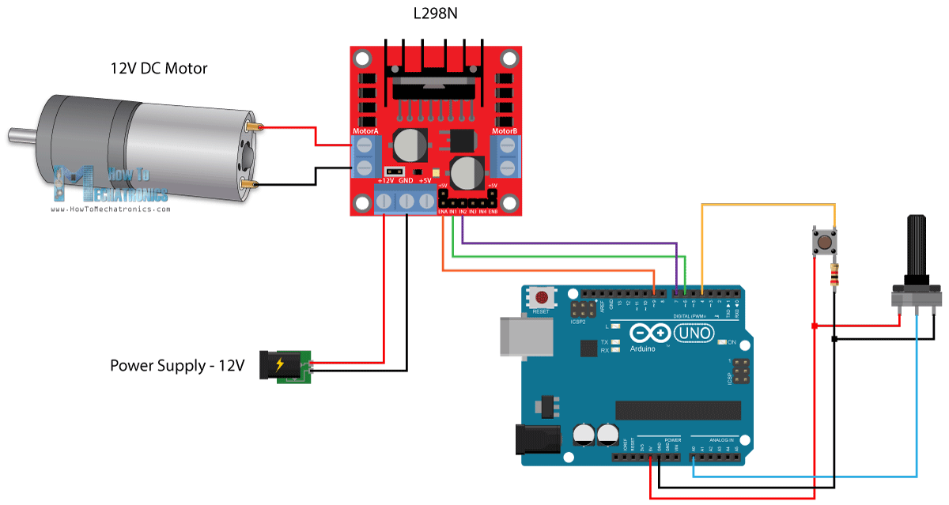
Basic Project -05 Control the Spin of Motor Circuit diagram

Slide 51
Project -06 : A Simple Home Security System
Basic Idea : To build an human detection System for your Home using Arduino on 220v AC.
Instruments:
Arduino
PIR Sensor.
Relay Module (The relay board works on 220V AC .So keep necessary safety measurements.).
LED and Buzzer.
Motor.
Jumper Wire and Breadboard.
L298 Motor Driver.

Slide 52
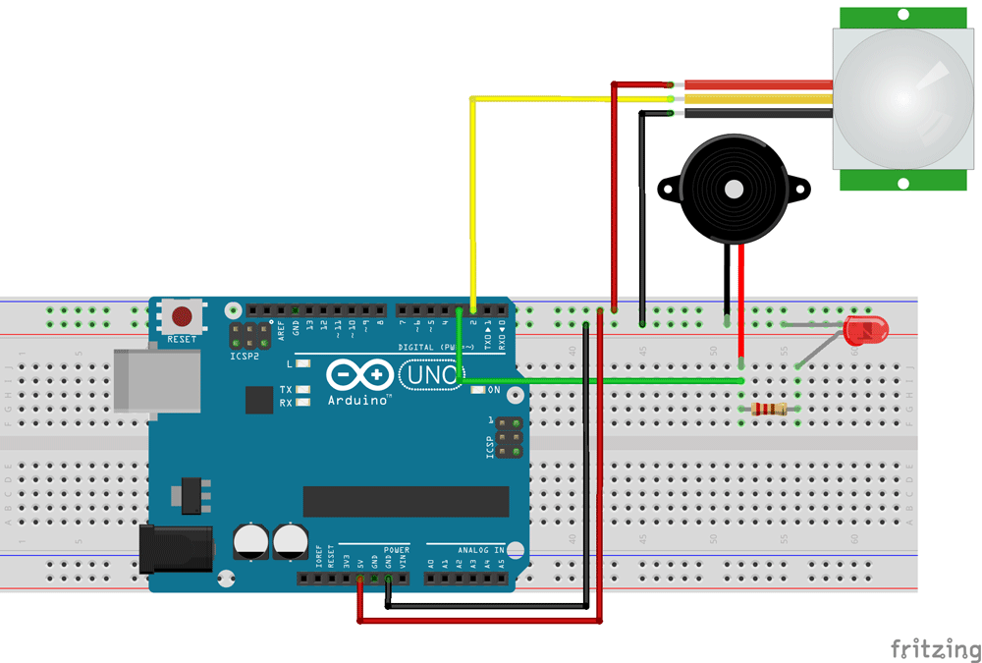
Project -06 :Smart home Security Circuit Diagram

Slide 53
Project-06: Sketch of Home Security System
void loop() {
int value = digitalRead(PIR);
if (value == HIGH){
digitalWrite(LED, HIGH);
digitalWrite(Buzzer, HIGH);
}
else {
digitalWrite(LED, LOW);
digitalWrite(Buzzer, LOW);
}
}
int LED = 3;
int PIR = 2;
int Buzzer = 7;
void setup()
{
pinMode(LED, OUTPUT);
pinMode(Buzzer, OUTPUT);
pinMode(PIR, INPUT);
}

Slide 54
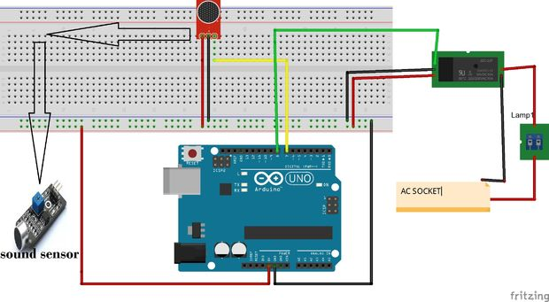
Project -07:Clap controlled Smart home Circuit Diagram

Slide 55

Video Tutorial of Building the Clap Control

Slide 56
Project References
http://www.instructables.com/technology/arduino/ for project idea.
https://playground.arduino.cc/Projects/Ideas .
https://codebender.cc/home for project code Must need Firefox/chrome.
https://github.com for project code.
https://youtube.com for tutorial.
https://learn.sparkfun.com/tutorials for tutorial.
https://www.allaboutcircuits.com/projects/category/arduino/ for tutorial.
https://diyhacking.com/diy-projects/arduino-projects/ for project idea.
http://mertarduinotutorial.blogspot.com for tutorial.
Arduino for Dummies by- John Nussey.
Arduino Programming by- Simon Monk.

Slide 57

Any Question ??

Slide 58
Thank You

